Slide 1
Hnaider Water Tower Project

Slide 2
Objectives:
Increase the efficiency of the implemented water network by covering the whole water demand of Hnaider residents including Syrian refugees.
Alleviate the chronic shortage of domestic water in Hnaider on a sustainable long-term basis, thereby improving the well-being of the inhabitants and decreasing the use of illegal water supply.
Support the Lebanese Government in developing the economic infrastructure sector in such remote area which was highly affected during the Syrian Crisis.
Relieve the associated economic, environmental, health and social stresses on the host communities.
Assist local residents in having a reliable water source all around the day.

Slide 3
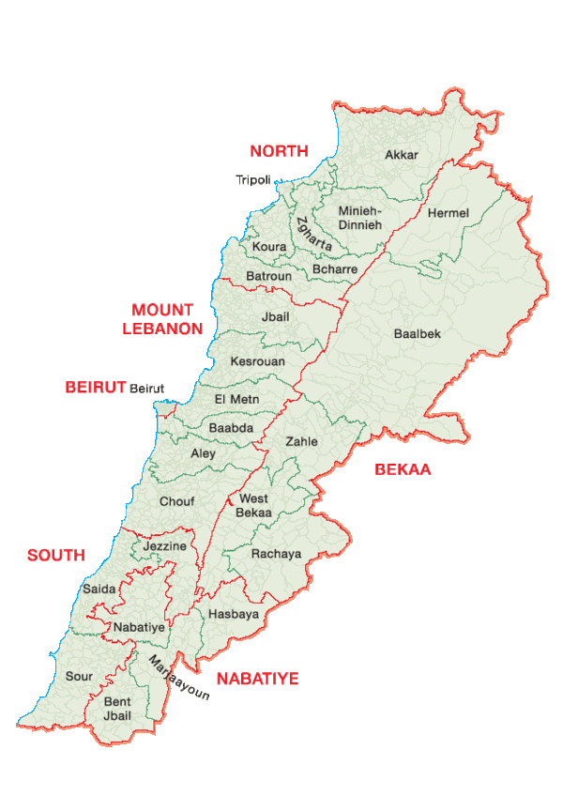
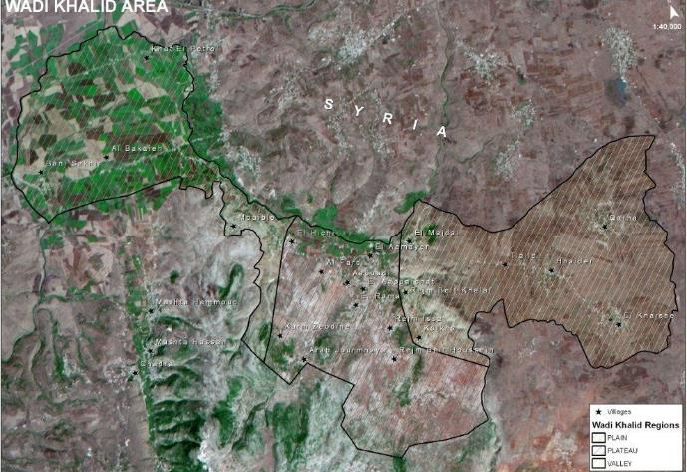
Geographic location:
Hnaider

Slide 4
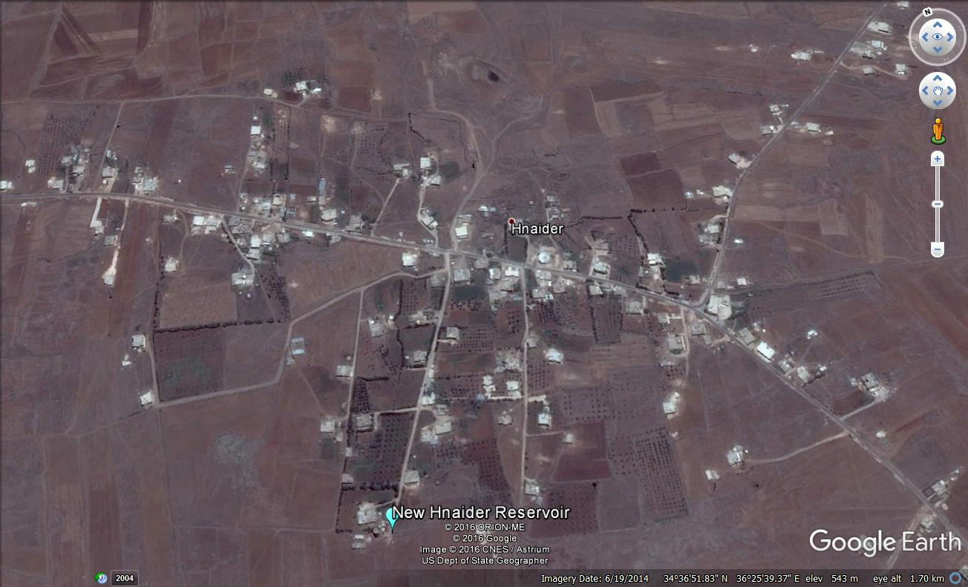
Existing Population:
Village | Lebanese Population | Syrian Refugees | Total Residents
Hnaider | 3200 | 2000 | 5200

Slide 5
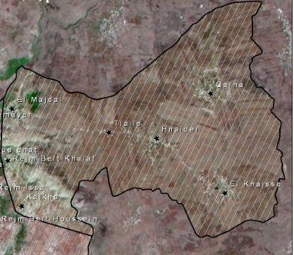
Project Concept:
New Water Reservoir
Households
Pump Station- Nabaa Es Safaa
Transmission Line

Slide 6
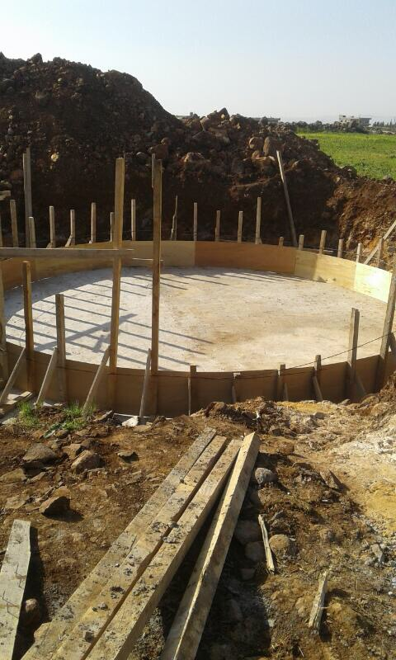
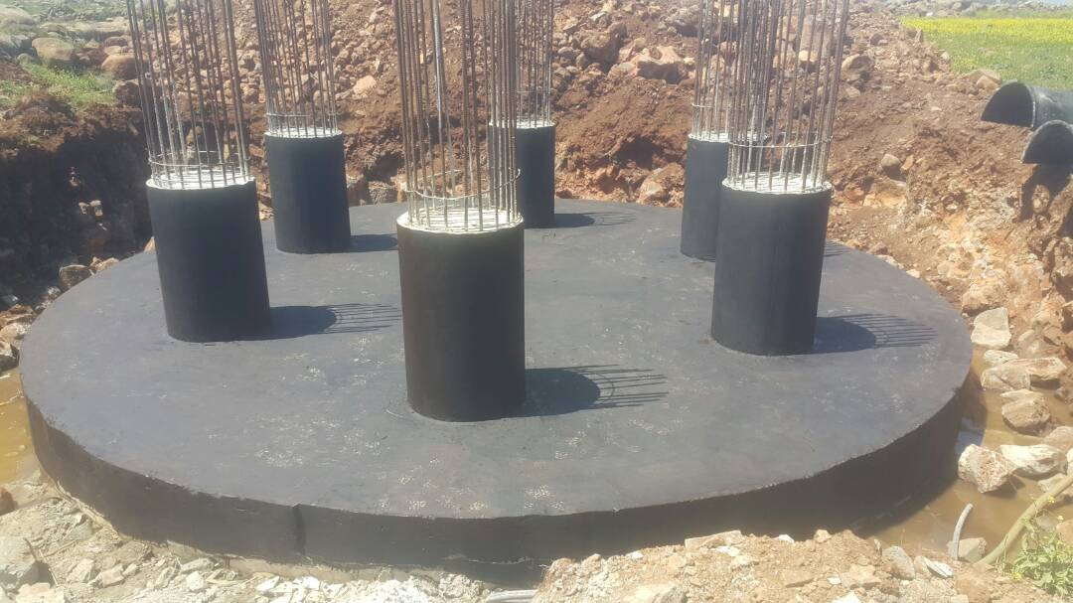
Implementation- Construction of the Reservoir:
The construction phase was launched by implementing a 10cm layer of blinding concrete before the beginning of the raft foundation.
The raft foundation started, and all works was prepared according to the design plans and technical drawings.

Slide 7
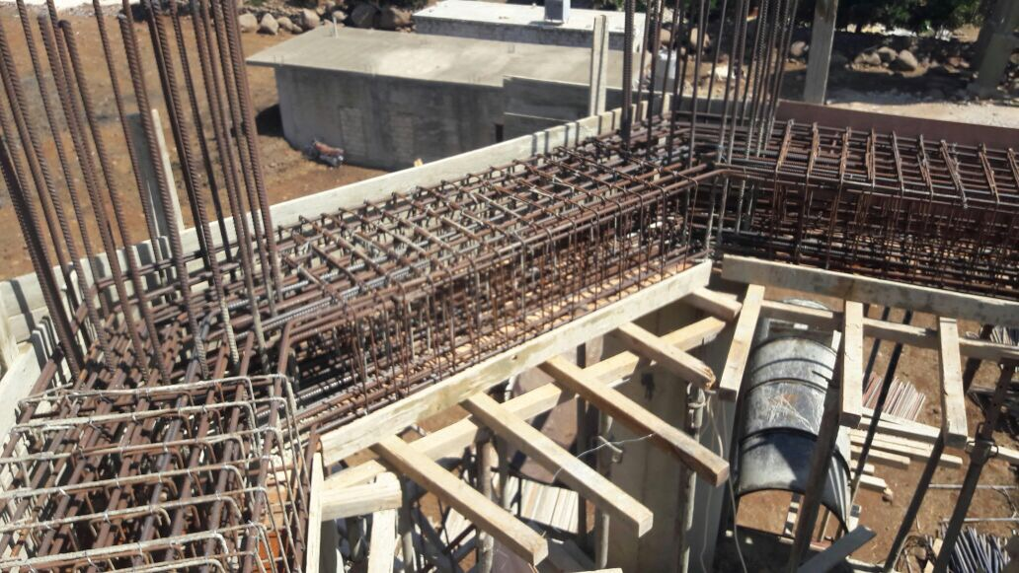
The reservoir is supported by 6 columns forming
a hexagonal shape, each column has a diameter
of 80 cm.
The structure also includes 5 identical beams at
different levels, each one has a thickness of 60 cm.

Slide 8
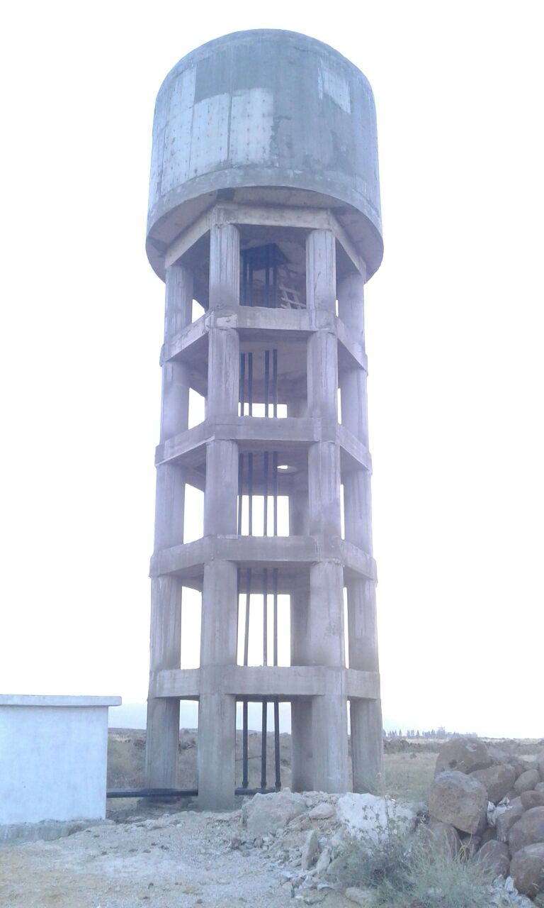
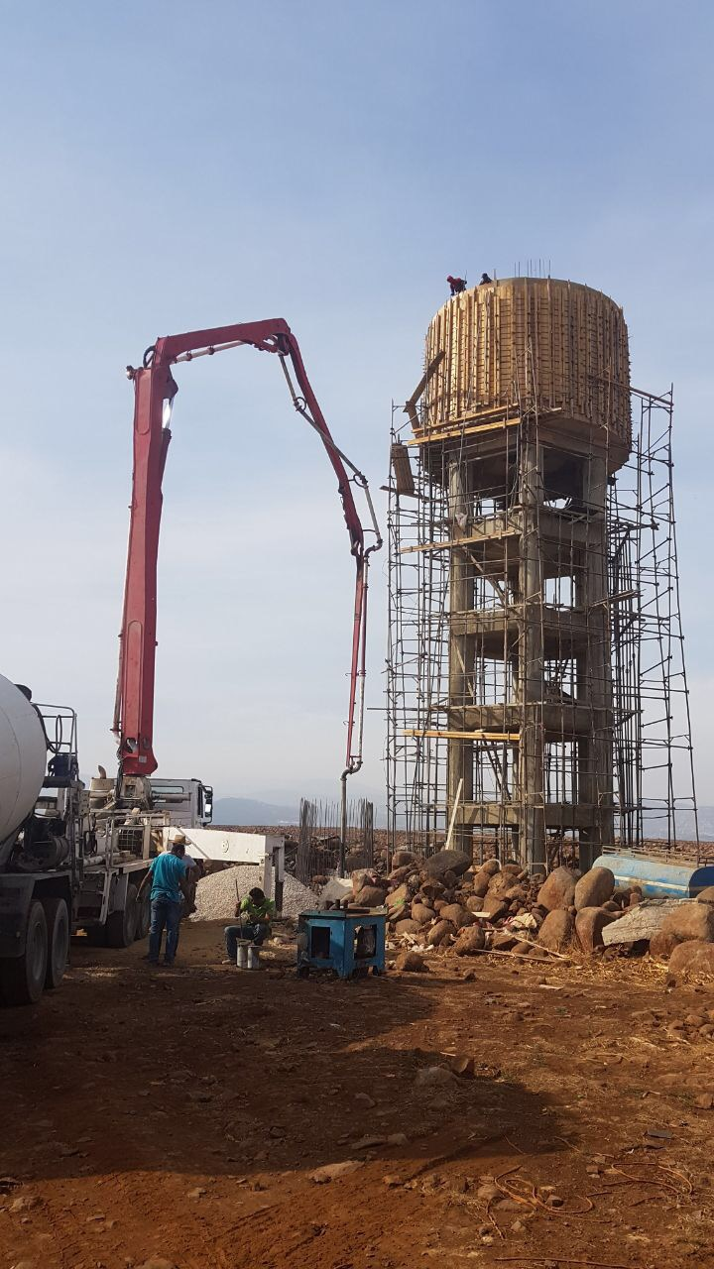

Slide 9
Project Results:
Before the Intervention | After the Intervention
Deficit in water balance between demand and supply | Water is available for all residents
The old reservoir was considered as an undersized structure by the Water Establishment | New elevated Reservoir takes into account the population growth for the coming 25 years
Shortage of water due to the influx of Syrian refugees | High capacity storage of the new reservoir lead to excess in water
Additional costs paid by residents and Syrian refugees for water trucking | Reduction in costs paid by individual for household water
Questionable quality of water supplied by private cisterns given often illegal nature of suppliers and undetermined sources | Lower risk of water contamination given increased use of water from the national water network made more available with the construction of the reservoir

Slide 10
Thank You

